Slide 1
Deep Learning
Security Analytics COSC 4397/6346
Instructor: Dr. Rakesh M. Verma
Spring 2019
University of Houston
Note: Resources and references are listed on the last slide.

Slide 2
Representation Learning
Idea proposed in “Deep Learning” by LeCun et. al., published in Nature Journal, 2015
Conventional machine learning algorithms cannot handle data in their raw form
Feature engineering and preprocessing steps before training
Representation learning methods
Raw data is fed in to discover better representations
Used for classification or recognition tasks

Slide 3
Deep Learning
Is a form of “Representation Learning” with multiple levels of representation learning
A Deep Neural Network is composed of:
Multiple levels of Representation
Each level has simple but non-linear modules
Each module contributes to transformation of the raw data to a more abstract representation
End-to-End learning concept

Slide 4
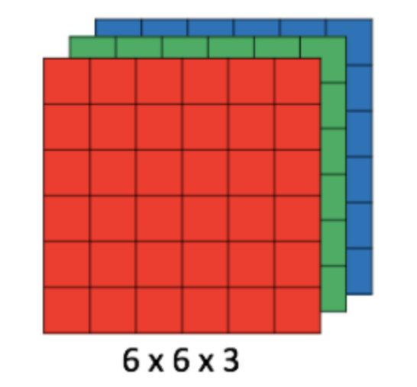
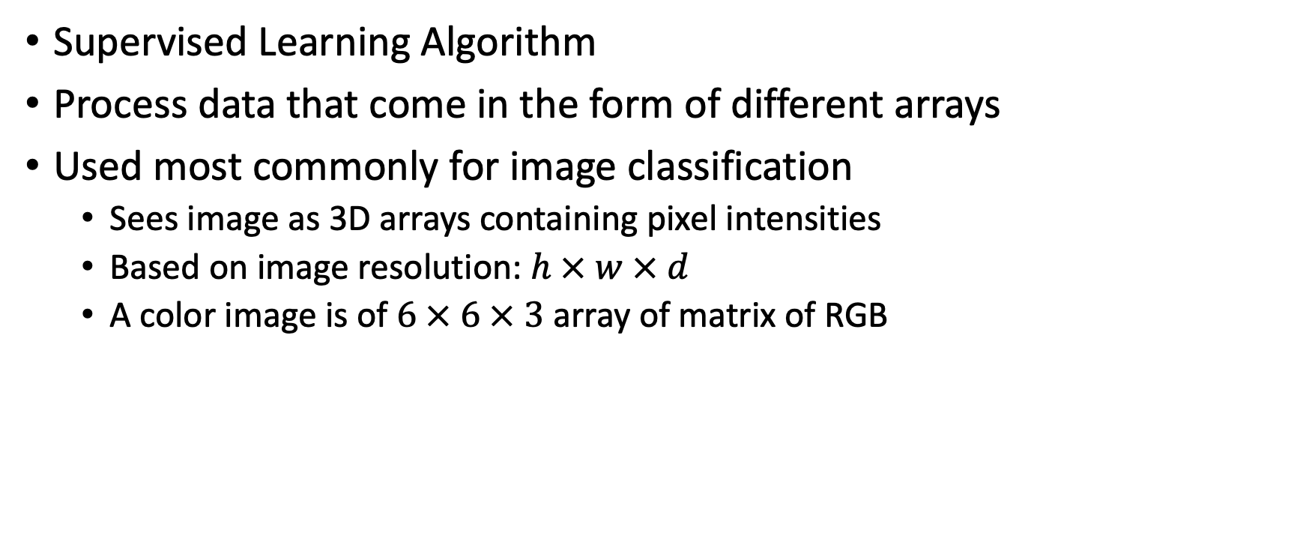
Convolutional Neural Network (ConvNets)
Supervised Learning Algorithm
Process data that come in the form of different arrays
Used most commonly for image classification
Sees image as 3D arrays containing pixel intensities
Based on image resolution: $h × w × d$
A color image is of $6 × 6 × 3$ array of matrix of RGB

Slide 5
Convolutional Neural Networks (CNNs)
Stages in a ConvNet
Convolution
ReLU
Pooling
Fully Connected
SoftMax

Slide 6
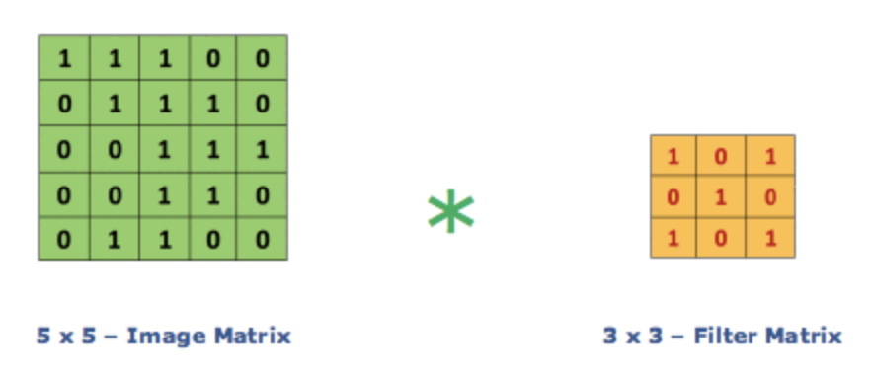

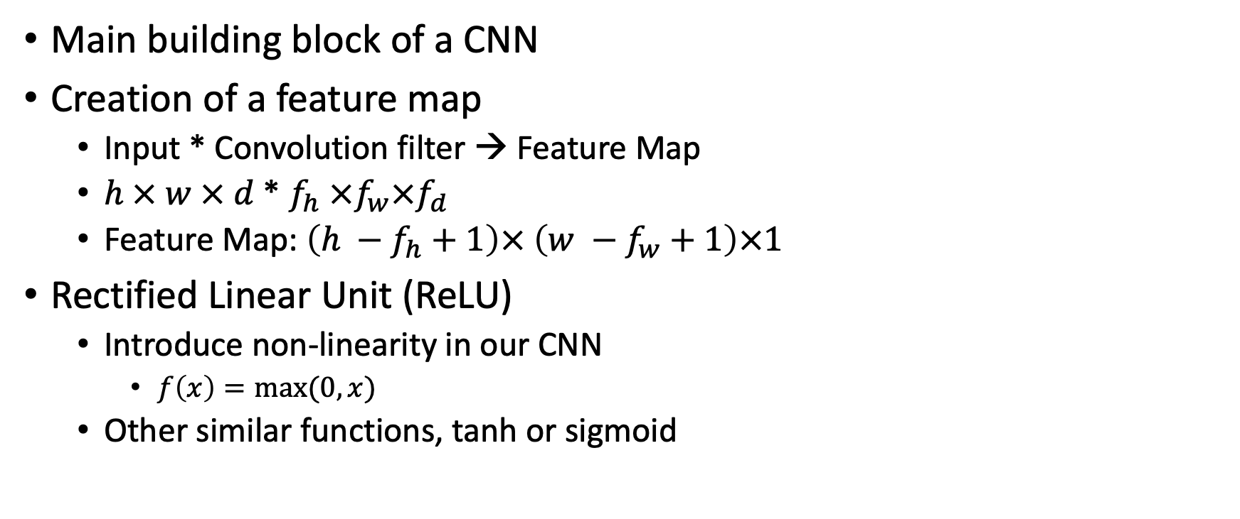
Convolution Layer and ReLU
Main building block of a CNN
Creation of a feature map
Input * Convolution filter → Feature Map
$h × w × d$ * $f_{h} ×f_{w}×f_{d}$
Feature Map: $\left(h −f_{h}+1\right)× \left(w −f_{w}+1\right)×1$
Rectified Linear Unit (ReLU)
Introduce non-linearity in our CNN
$f\left(x\right)=max⁡(0,x)$
Other similar functions, tanh or sigmoid

Slide 7
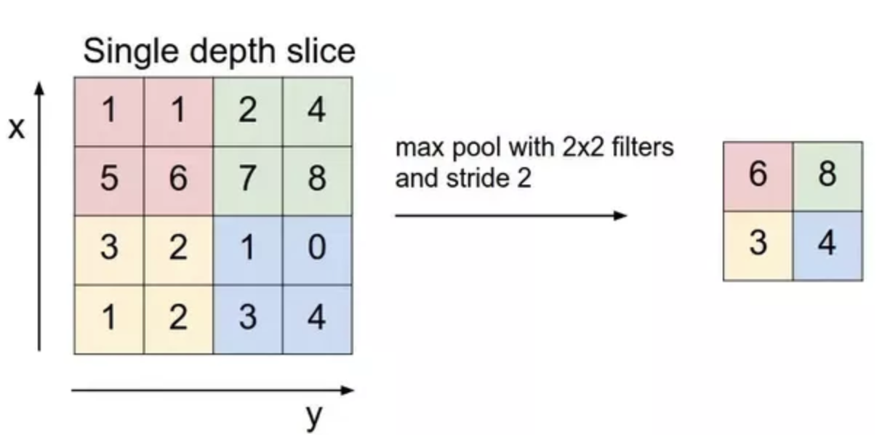
Pooling Layer
Reduces the number of parameters in case of large inputs
Spatial pooling reduces dimensionality of each map without loss of information
Types
Max Pooling
Average Pooling
Sum Pooling
Advantages:
shortens the training time
combats overfitting

Slide 8
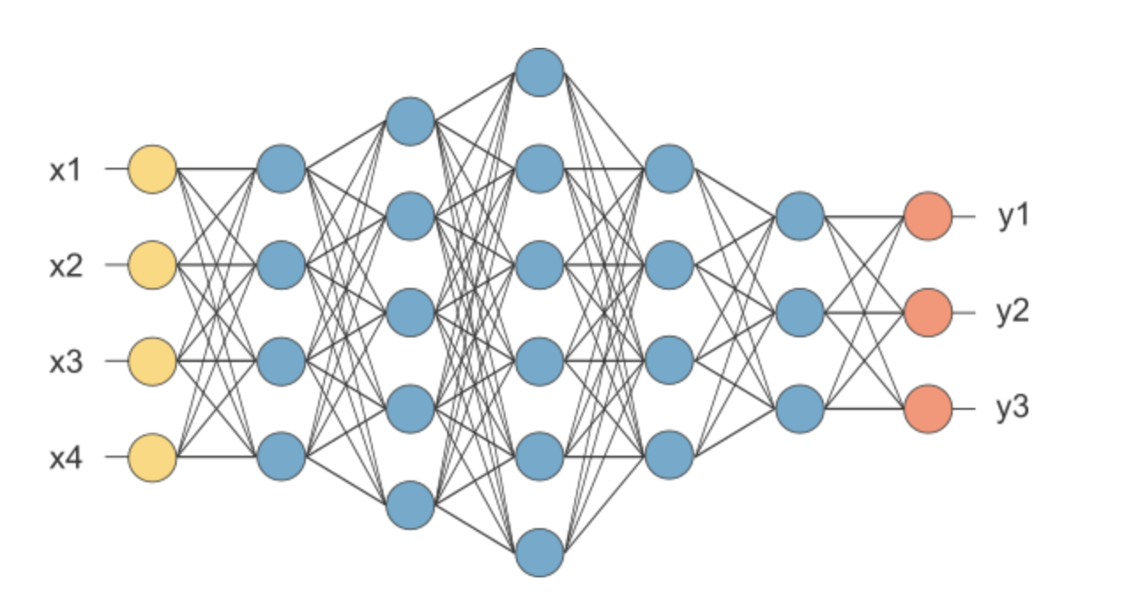
Fully Connected Layer and SoftMax
Flatten: Convert the outputs of the convolution and pooling layers from 3D to 1D
Fully Connected Layer acts as a classifier
SoftMax: Final Activation Layer to output the probabilities

Slide 9
Shortcomings of a CNN
Accept a fixed size vector as input and output
How do we learn a representation of a sequential input?

Slide 10
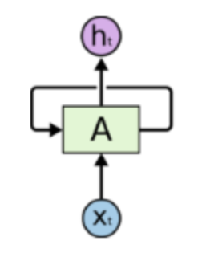
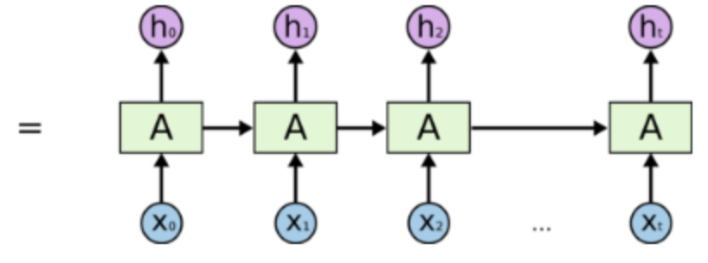
Recurrent Neural Networks (RNNs)
Human thoughts have persistence
RNNs take into account context in their inputs
Multiple copies of the same network
The message passes from one unit to its successor

Slide 11
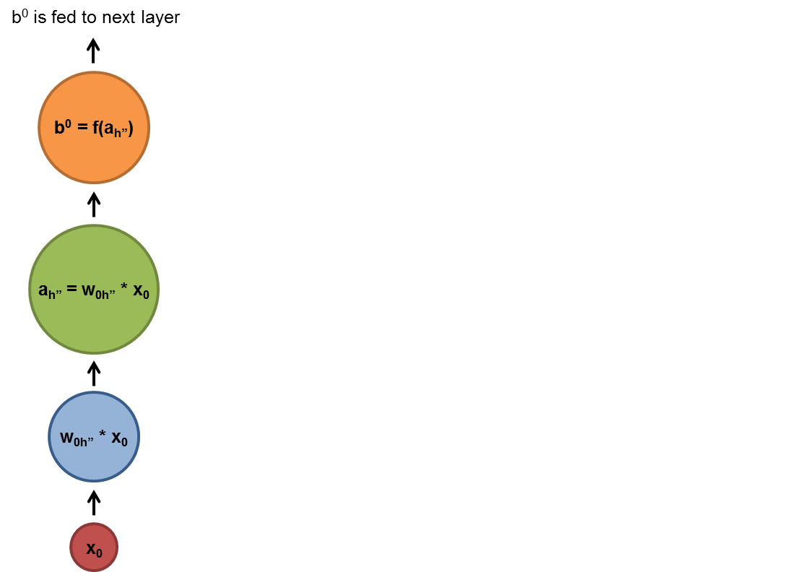
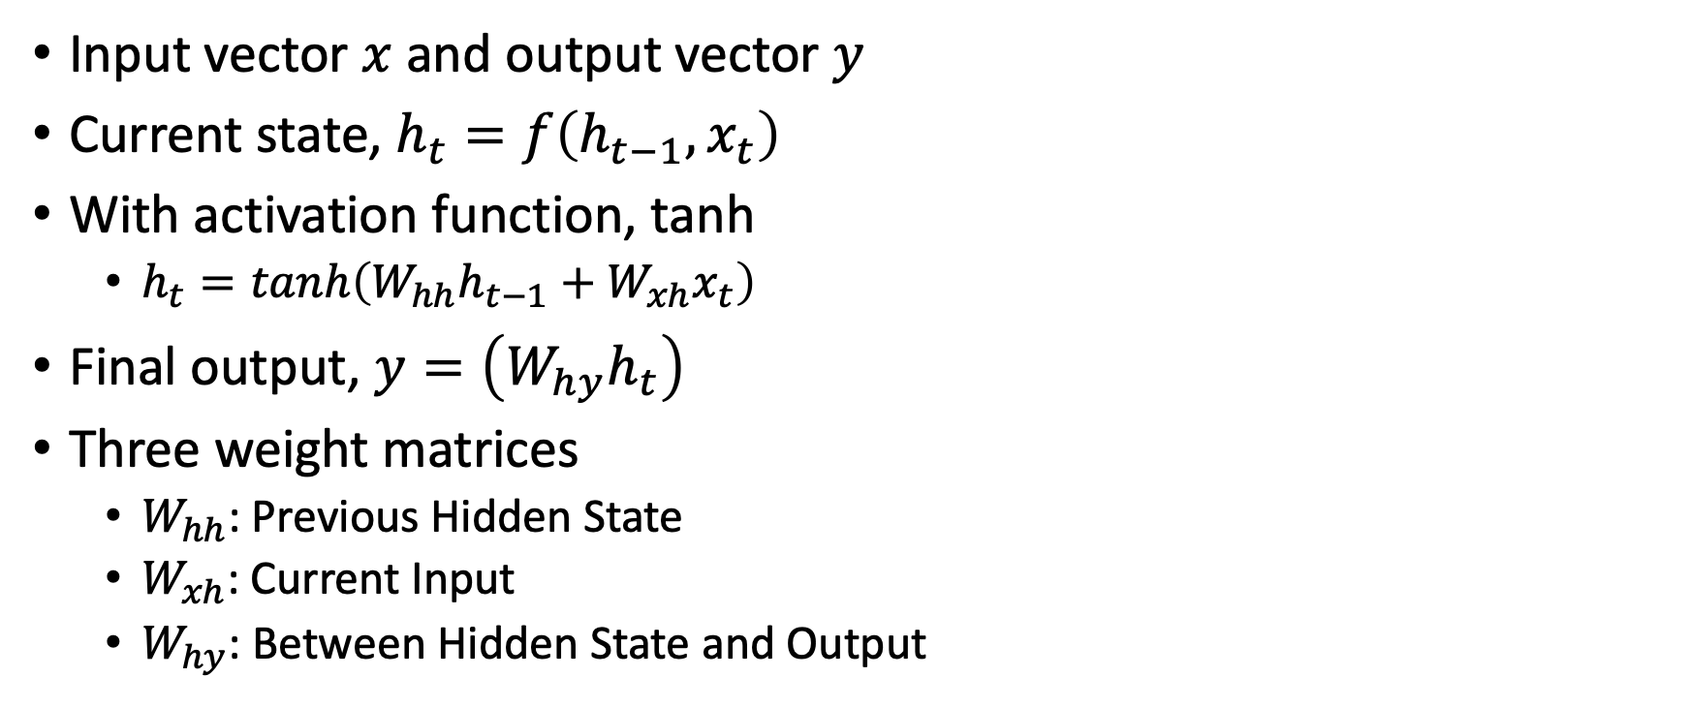
Recurrent Neural Networks (RNN)
Input vector $x$and output vector $y$
Current state, $h_{t}=f\left(h_{t−1}, x_{t}\right)$
With activation function, tanh
$h_{t}=tanh\left(W_{hh}h_{t−1}+W_{xh}x_{t}\right)$
Final output, $y=\left(W_{hy}h_{t}\right)$
Three weight matrices
$W_{hh}$: Previous Hidden State
$W_{xh}$: Current Input
$W_{hy}$: Between Hidden State and Output

Slide 12
Applications and Types of RNN
Applications
Language Modelling and Text Generation
Machine Translation
Speech Recognition
Generation of Image Captions
Video Tagging
Types
LSTM
GRU

Slide 13
Simple Auto-encoders
Generative model used for Unsupervised applications
Input is same as the output

Slide 14

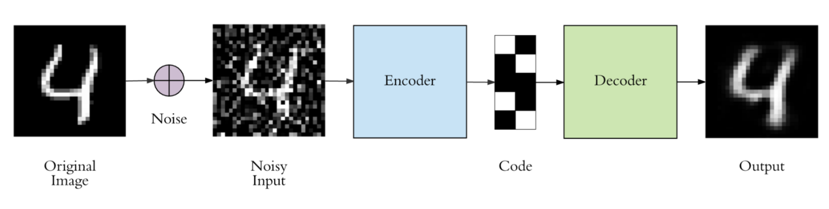
Simple Auto-encoders
Learn features from an input and reconstruct the output from given image
Features are called latent representation of the input
Properties of an Autoencoder
Data-specific
Lossy
Unsupervised/self-supervised
Parts of an Autoencoder Architecture
Encoder
Decoder
Not as effective as GANs

Slide 15
Generative Adversarial Networks
Two players performing two entirely different roles
Generator
Produce new data from noise
Maximize the probability of fooling discriminator
Discriminator
Acts as the judge
Decides between real and generated
Guides the generator
In equilibrium,
Generator perfectly captures the input data distribution
Discriminator is confused

Slide 16
Resources and References
Deep Learning, Nature Journal, 2015
Getting Started with Keras, https://keras.io/
Working with Google Colab, https://colab.research.google.com/notebooks/welcome.ipynb
Some blogs:
https://medium.com/@RaghavPrabhu/understanding-of-convolutional-neural-network-cnn-deep-learning-99760835f148
https://hackernoon.com/rnn-or-recurrent-neural-network-for-noobs-a9afbb00e860
https://towardsdatascience.com/autoencoders-made-simple-6f59e2ab37ef
https://medium.freecodecamp.org/an-intuitive-introduction-to-generative-adversarial-networks-gans-7a2264a81394

